Slide 1

Course Project 2: Phoneme Classification
Hands on Artificial Intelligence and Robotics
Lingxiao Wang, Ph.D.
Assistant Professor of Electrical Engineering
Louisiana Tech University

Slide 2
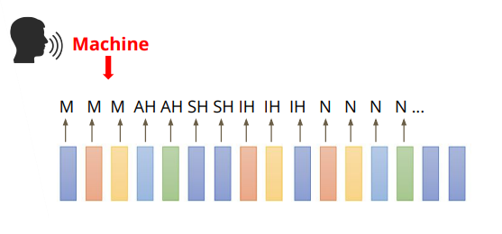

Course Project 2: Phoneme Classification
Objective:
Perform framewise phoneme classification.
What is a phoneme?
Phoneme is a unit of speech sound in a language that can serve to distinguish one word from the other.

Slide 3
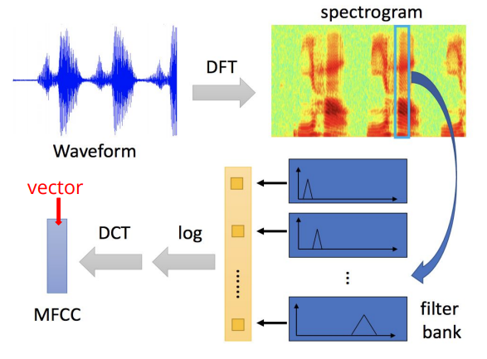
Data Preprocessing
MFCC (Mel Frequency Cepstral Coefficients) – Acoustic Features.
Convert a frame of sound signals into a vector.

Slide 4
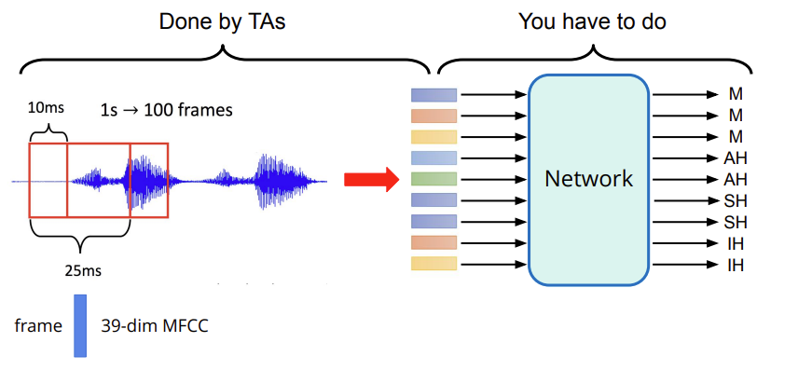
Task Introduction
We will divide a sound signal into multiple frames and design a neural network to classify phoneme.
One frame is 25 ms:
1 second sound signal contains 100 frames (overlapping in frames)
The distance between two consecutive frames is 10 ms.

Slide 5
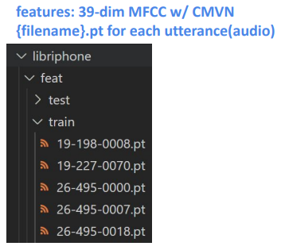
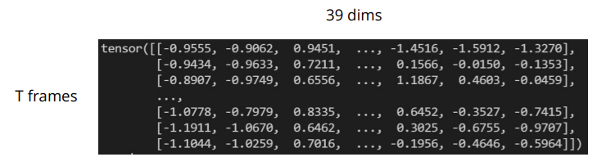
Dataset
LibriSpeech
Training: preprocessed audio signals with labels
Testing: preprocessed audio signals with labels
Label: 41 classes, each class represents a phoneme
Data Format:
Each .pt file is extracted from one original audio file
Use torch.load() to read .pt files as torch tensors
Each tensor has a shape of (T, 39)
T: number of frames in this audio file
39: dimension of a frame

Slide 6
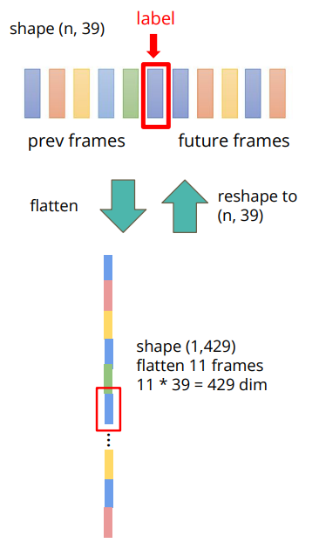
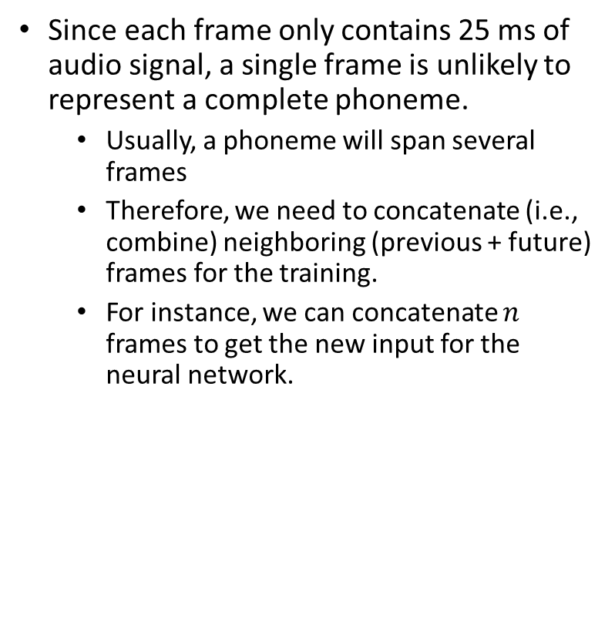
Concatenate Multiple Frames
Since each frame only contains 25 ms of audio signal, a single frame is unlikely to represent a complete phoneme.
Usually, a phoneme will span several frames
Therefore, we need to concatenate (i.e., combine) neighboring (previous + future) frames for the training.
For instance, we can concatenate $n$ frames to get the new input for the neural network.
n=11

Slide 7
Grading
 | Test Acc | Hints | Training Time | Grade
Simple | > 0.4 | Sample Code | ~ 15 mins | 85
Medium | > 0.5 | Concat n frames, add layers, increase epochs | ~30 mins | 90
Strong | > 0.6 | Batchnorm, dropout | ~1 hour | 95
Boss | > 0.7 | Sequence-labeling (RNN) | 3~4 hours | 100

Slide 8
Colab Link
https://colab.research.google.com/drive/1P8IZaySD9a2bu6kka2hZZxBbuZUk0W-h?usp=sharing

